Slide 1

Data and Information Management
Week 2 – Preparation for Lab 1
Dr Farshid Keivanian

Slide 2
Week 2 – Lab 1
Unit Overview
Databases play a critical role in modern organisations, enabling efficient data storage, retrieval, and management while ensuring security and integrity. This unit provides students with both theoretical foundations and practical skills in database design, development, and implementation using Microsoft Azure SQL Database and SQL programming.
2 | Faculty of Business and Law | Peter Faber Business School

Slide 3
Week 2 – Lab 1
Throughout this unit, students will:
Identify and model organisational information requirements.
Design conceptual and logical data models.
Implement relational and non-relational databases.
Develop SQL queries for data manipulation and analysis.
Explore cloud-based database technologies.
Learn database security principles and ethical considerations.
This unit aligns with Microsoft’s curriculum and provides a pathway to the DP-900: Microsoft Azure Data Fundamentals Certification.
2 | Faculty of Business and Law | Peter Faber Business School

Slide 4
Week 2 – Lab 1
Assessment Overview and Guidelines
Assessment Task 1: Practical Database Exercises
Description: This assessment consists of weekly lab exercises covering:
Conceptual Data Modelling
Physical Database Design using RDBMS
SQL Programming and Data Manipulation
2 | Faculty of Business and Law | Peter Faber Business School

Slide 5
Week 2 – Lab 1
Objective: Students will demonstrate their theoretical knowledge and practical skills by creating a database and applying SQL programming techniques.
Submission Type: Individual
Assessment Method: Lab Practical Task
Deliverables: ER Diagram + SQL Code
Weighting: 25%
Learning Outcomes Assessed: LO2, LO3
2 | Faculty of Business and Law | Peter Faber Business School

Slide 6
Week 2 – Lab 1
Assessment Task 2: Microsoft Azure Data Fundamentals Certification Exam (DP-900)
Description: Students are required to complete the Microsoft Azure Data Fundamentals (DP-900) Certification Exam, which assesses foundational knowledge of core data concepts and their implementation in Azure data services.
Exam Details:
53 questions
Duration: 60 minutes
Passing Score: 700 (on a scale of 100-1000)
Weighting: 35%
Learning Outcomes Assessed: LO1
2 | Faculty of Business and Law | Peter Faber Business School

Slide 7
Week 2 – Lab 1
Assessment Task 3: Capstone Database Project
Description: Students will design, implement, and manage a database system using Azure SQL Database Management System and SQL programming. This task involves:
Logical and Physical Database Design
SQL Queries for Data Manipulation
Database Security Enhancements
Report on Security and Ethical Considerations
2 | Faculty of Business and Law | Peter Faber Business School

Slide 8
Week 2 – Lab 1
Objective: Students must demonstrate their ability to design secure, scalable, and efficient databases while considering ethical data management.
Submission Type: Individual
Assessment Method: Practical Task + Report + Presentation
Deliverables: Database File + SQL Code + Written Report + Presentation
Weighting: 40%
Learning Outcomes Assessed: LO2, LO3, LO4
This capstone project reinforces the application of database principles in real-world organisational scenarios.
2 | Faculty of Business and Law | Peter Faber Business School

Slide 9
Week 2 – Lab 1
Assessment Strategy and Rationale
To successfully complete this unit, students must achieve a minimum aggregate score of 50%.
Assessment Strategy:
Assessment 1 provides a hands-on approach to database design and SQL programming.
Assessment 2 validates students’ database knowledge through an industry-recognised certification.
Assessment 3 develops students’ ability to design scalable, secure, and efficient database solutions.
2 | Faculty of Business and Law | Peter Faber Business School

Slide 10
Week 2 – Lab 1
Microsoft Online Learning Materials:
Azure Data Fundamentals: Core Data Concepts https://learn.microsoft.com/en-us/certifications/exams/dp-900/
Azure Data Fundamentals: Relational Data in Azure https://learn.microsoft.com/en-us/azure/
Azure Data Fundamentals: Non-Relational Data in Azure https://learn.microsoft.com/en-us/azure/cosmos-db/
Azure Data Fundamentals: Modern Data Warehouses https://learn.microsoft.com/en-us/azure/cosmos-db/
2 | Faculty of Business and Law | Peter Faber Business School

Slide 11
Week 2 – Lab 1
Final Notes
This unit is designed to equip students with modern database management skills and prepare them for industry certifications. We encourage you to stay engaged, participate actively, and leverage the available learning resources to gain a strong foundation in database technologies.
For any inquiries, please contact Farshid.Keivanian@acu.edu.au
Looking forward to an exciting semester ahead!
2 | Faculty of Business and Law | Peter Faber Business School

Slide 12
Week 2 – Lab 1
This lab will guide you through installing MySQL Community Server and MySQL Workbench, essential tools for working with MySQL databases. Here’s a step-by-step instruction set using simple language for students:
2 | Faculty of Business and Law | Peter Faber Business School

Slide 13
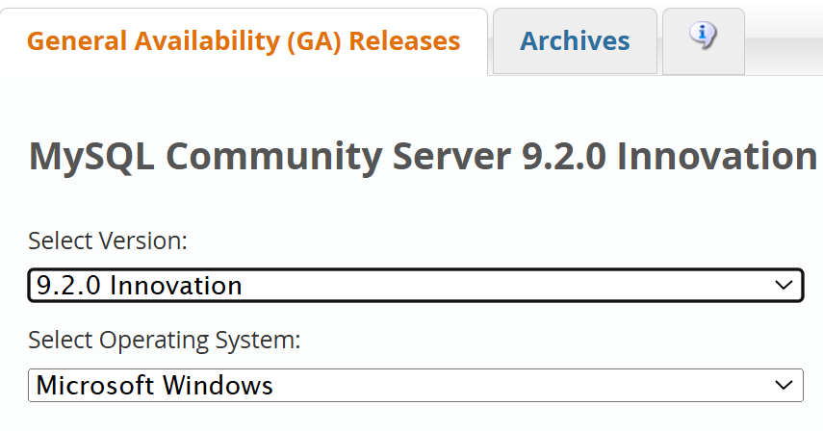
Week 2 – Lab 1
Step 1: Downloading and Installing MySQL Server
Go to the MySQL Community Server Download Page Open MySQL Download Page in your browser.
Select the Required Version
Choose 9.2.0 Innovation from the dropdown list.
Choose Your Operating System
If you’re on macOS, select macOS.
If you’re on Windows, choose Windows.
2 | Faculty of Business and Law | Peter Faber Business School

Slide 14
Week 2 – Lab 1
Select the Correct OS Version
If using macOS 15 or later, pick macOS 15 (x86, 64-bit).
Download the DMG File
Click the blue "Download" button.
2 | Faculty of Business and Law | Peter Faber Business School

Slide 15
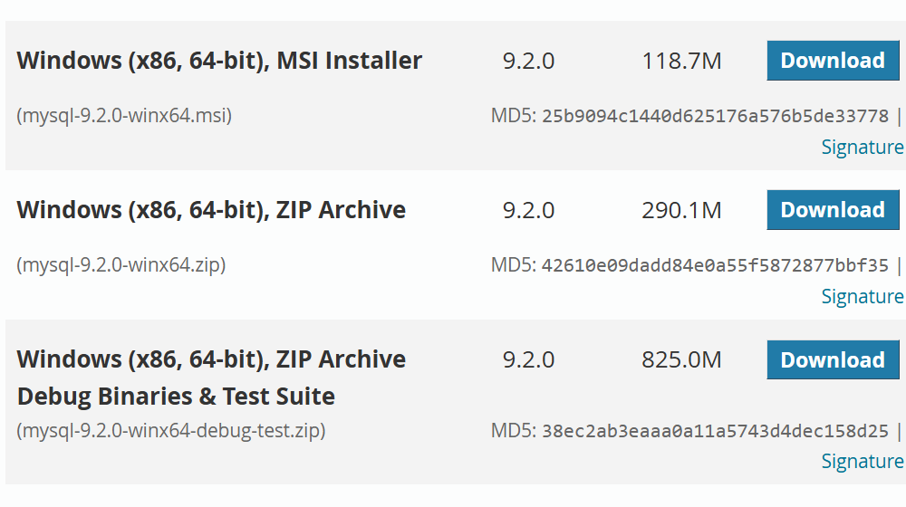
Week 2 – Lab 1
Windows (x86, 64-bit), MSI Installer (118.7M)
File: mysql-9.2.0-winx64.msi
Recommended for an easy installation with a guided setup.
Best choice if you want a quick and straightforward installation.
2 | Faculty of Business and Law | Peter Faber Business School

Slide 16
Week 2 – Lab 1
Windows (x86, 64-bit), ZIP Archive (290.1M)
File: mysql-9.2.0-winx64.zip
A portable version that requires manual setup.
Use this if you prefer a manual installation without an installer.
2 | Faculty of Business and Law | Peter Faber Business School

Slide 17
Week 2 – Lab 1
Windows (x86, 64-bit), ZIP Archive Debug Binaries & Test Suite (825.0M)
File: mysql-9.2.0-winx64-debug-test.zip
For advanced users who need debugging and testing tools.
Not needed for regular installation.
2 | Faculty of Business and Law | Peter Faber Business School

Slide 18
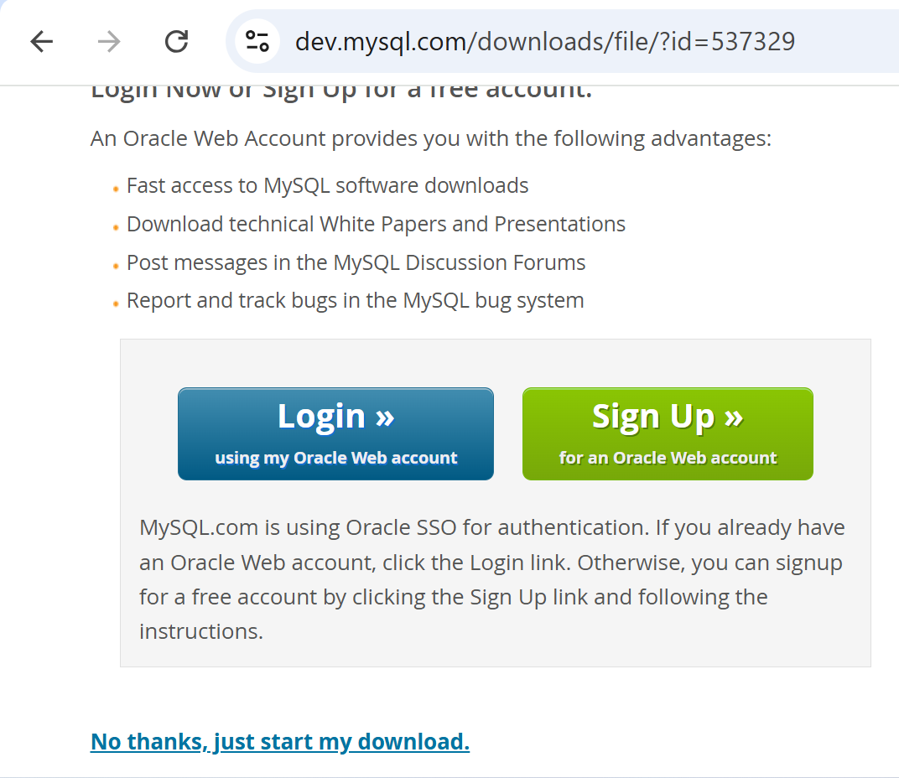
Week 2 – Lab 1
2 | Faculty of Business and Law | Peter Faber Business School

Slide 19
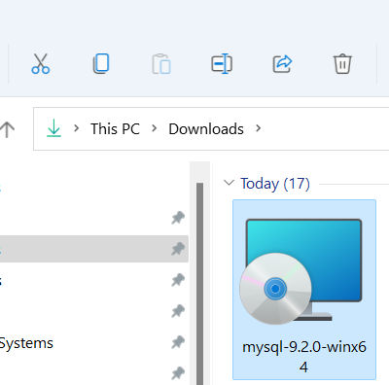
Week 2 – Lab 1
2 | Faculty of Business and Law | Peter Faber Business School

Slide 20
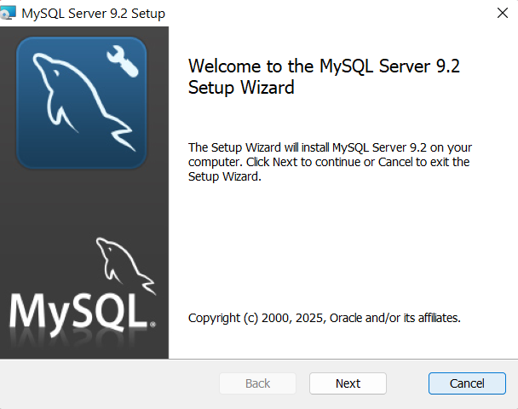
Week 2 – Lab 1
2 | Faculty of Business and Law | Peter Faber Business School

Slide 21
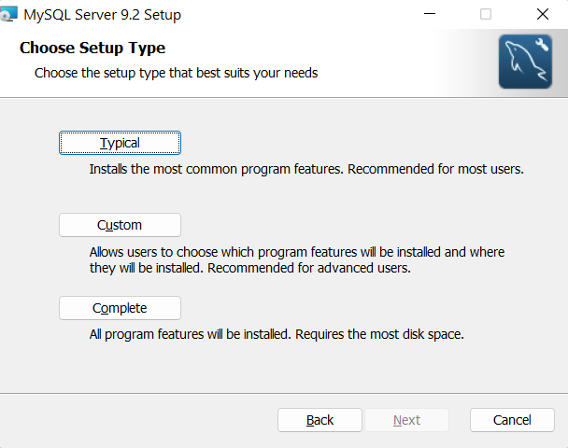
Week 2 – Lab 1
Why Choose "Typical"?
It includes all essential features needed for our database exercises.
Easy and quick setup without requiring advanced configurations.
Best for most users, especially for students who need MySQL for database-related labs.
Includes MySQL Server, MySQL Workbench, and command-line tools.
2 | Faculty of Business and Law | Peter Faber Business School

Slide 22
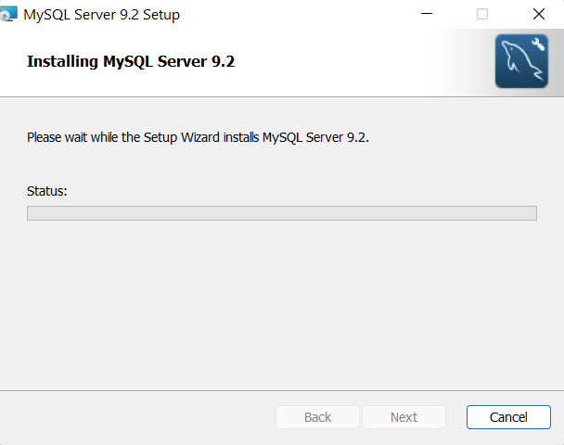
Week 2 – Lab 1
2 | Faculty of Business and Law | Peter Faber Business School

Slide 23
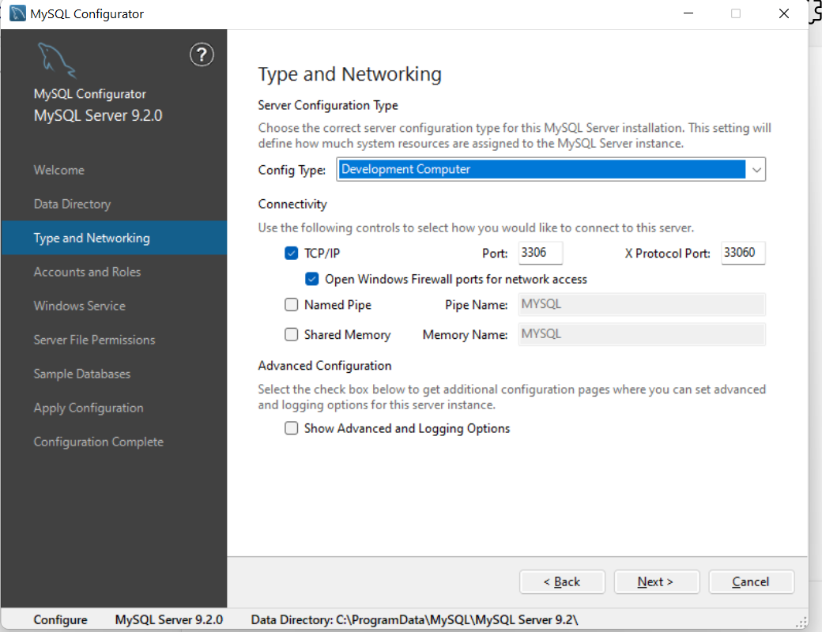
Week 2 – Lab 1
Configuration Type:
Development Computer (Best for students and local database setup)
Uses fewer system resources.
Suitable for testing and learning MySQL.
Ideal for local development and practice.
2 | Faculty of Business and Law | Peter Faber Business School

Slide 24
Week 2 – Lab 1
Connectivity:
Enable TCP/IP (Port: 3306) (Already selected)
This allows MySQL Workbench or other applications to connect.
Port 3306 is the default MySQL port—keep it as is.
2 | Faculty of Business and Law | Peter Faber Business School

Slide 25
Week 2 – Lab 1
Check "Open Windows Firewall ports for network access"
This ensures that MySQL can be accessed if needed.
Keeps it accessible from MySQL Workbench.
2 | Faculty of Business and Law | Peter Faber Business School

Slide 26
Week 2 – Lab 1
X Do NOT select Named Pipe or Shared Memory
These are advanced options used for specific Windows environments.
Not required for your course.
2 | Faculty of Business and Law | Peter Faber Business School

Slide 27
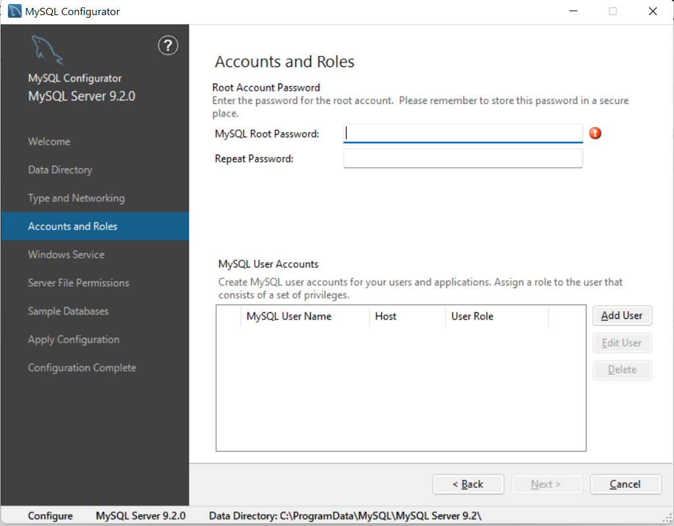
Week 2 – Lab 1
Set a Strong Root Password
The root account has full control over the MySQL database.
Choose a strong password that includes:
Uppercase & lowercase letters
Numbers
Special characters (!@#$%^&*)
2 | Faculty of Business and Law | Peter Faber Business School

Slide 28
Week 2 – Lab 1
Do You Need to Add Users?
For labs and coursework: Skip this step for now.
Additional user accounts can be created later in MySQL Workbench or using SQL commands.
2 | Faculty of Business and Law | Peter Faber Business School

Slide 29
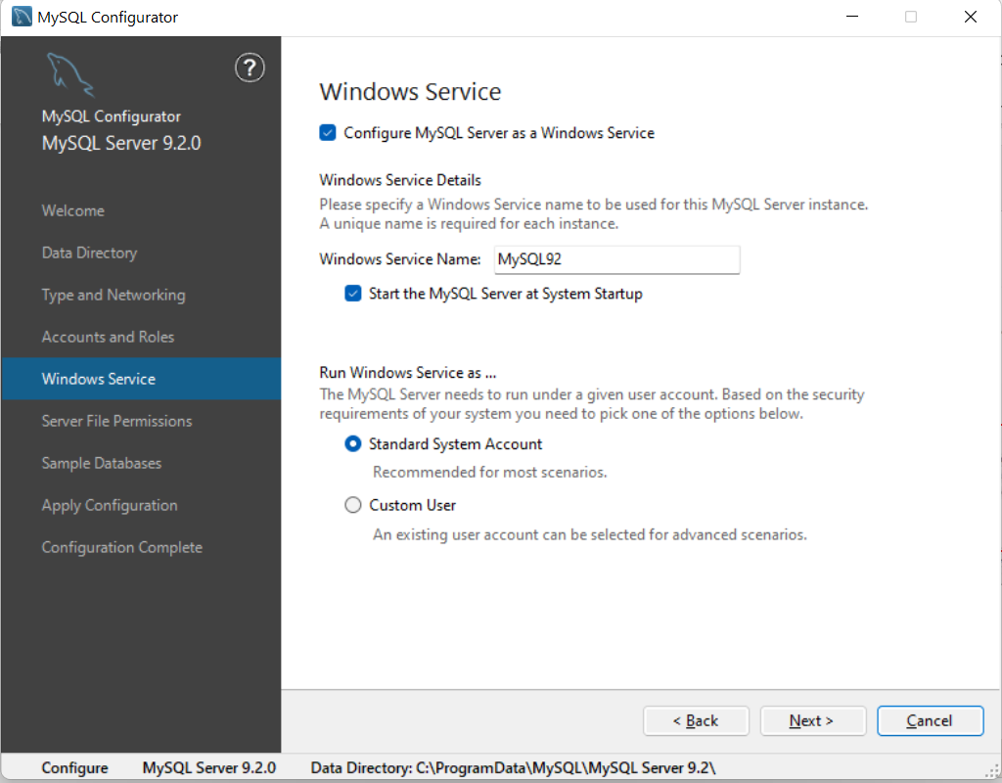
Week 2 – Lab 1
Keep "Configure MySQL Server as a Windows Service" CHECKED
This allows MySQL to run in the background automatically.
You won’t have to start MySQL manually every time you restart your computer.
2 | Faculty of Business and Law | Peter Faber Business School

Slide 30
Week 2 – Lab 1
Set the Windows Service Name
The default is "MySQL", but in your case, it is set as "MySQL92", which is fine.
If you are running multiple MySQL versions, a unique name helps distinguish them.
2 | Faculty of Business and Law | Peter Faber Business School

Slide 31
Week 2 – Lab 1
Keep "Start the MySQL Server at System Startup" CHECKED
This ensures MySQL automatically starts when you turn on your computer.
Recommended for easy access without needing to start it manually.
2 | Faculty of Business and Law | Peter Faber Business School

Slide 32
Week 2 – Lab 1
Choose "Standard System Account“
Recommended for most scenarios, as MySQL runs securely under Windows.
Do NOT choose "Custom User" unless you have a specific reason (e.g., managing multiple MySQL instances with different permissions).
2 | Faculty of Business and Law | Peter Faber Business School

Slide 33
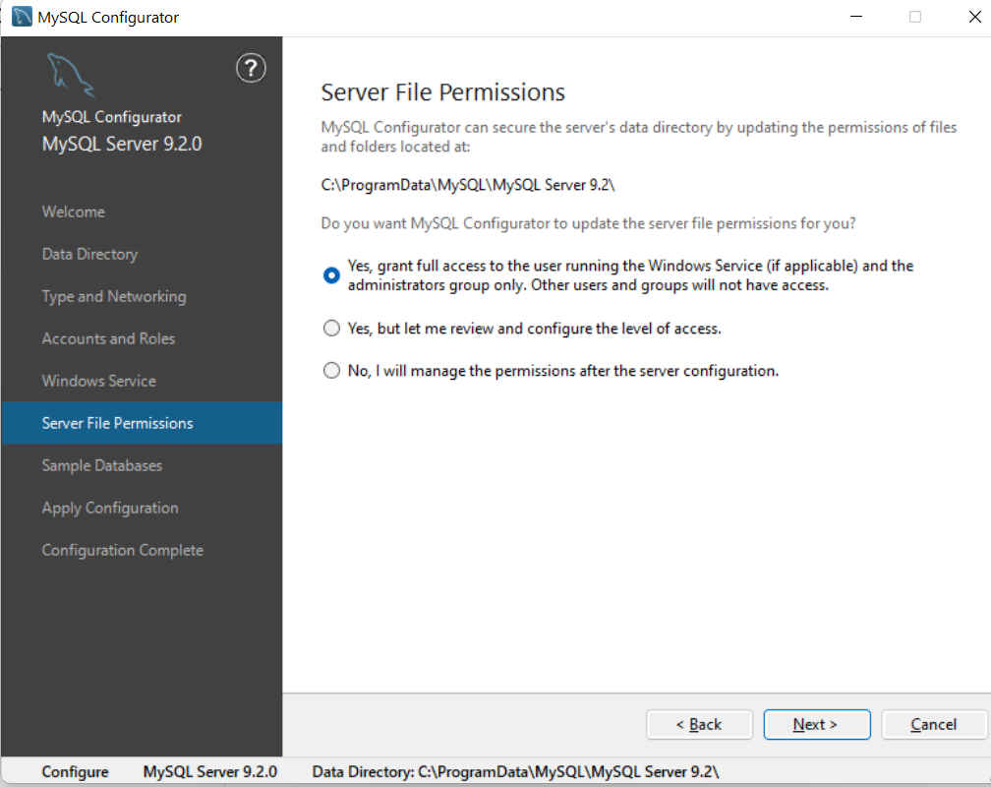
Week 2 – Lab 1
"Yes, grant full access to the user running the Windows Service (if applicable) and the administrators group only. Other users and groups will not have access." (This is already selected.)
Why Choose This Option?
Ensures MySQL data files are protected.
Grants access only to the MySQL service and Windows administrators.
Prevents unauthorized users or applications from modifying the MySQL data directory.
2 | Faculty of Business and Law | Peter Faber Business School

Slide 34
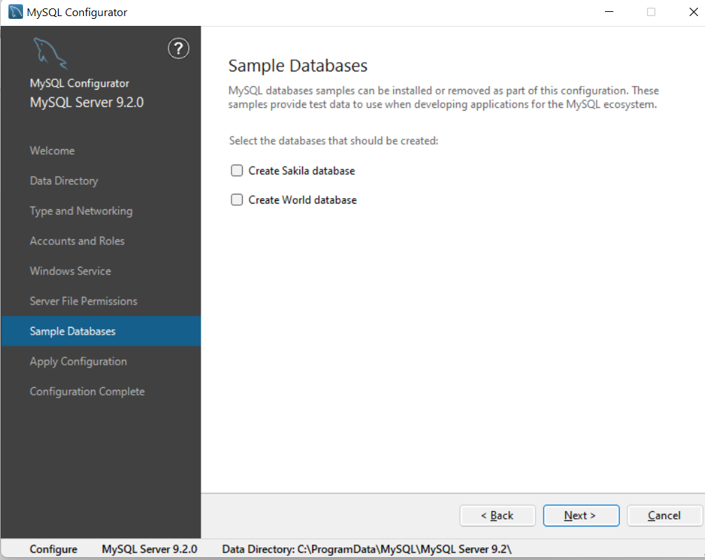
Week 2 – Lab 1
Sakila Database → Useful for learning advanced SQL queries related to a movie rental business.
World Database → Contains country, city, and language data, useful for basic SQL queries
2 | Faculty of Business and Law | Peter Faber Business School

Slide 35
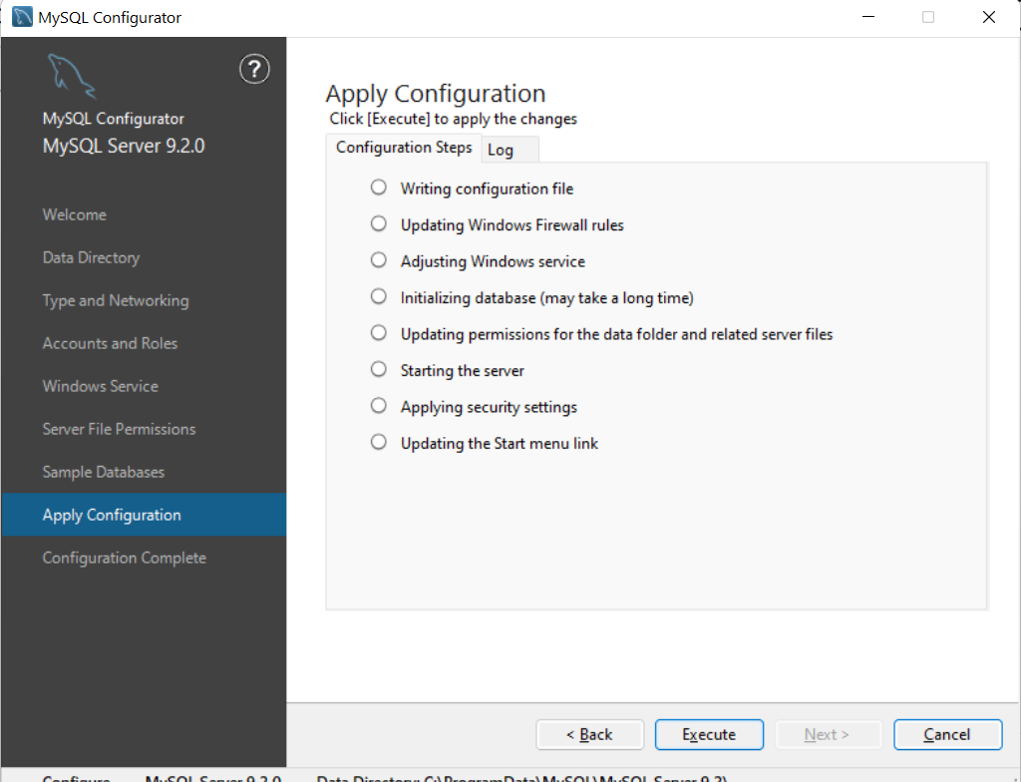
Week 2 – Lab 1
Click "Execute"
This will apply all the settings you configured in the previous steps.
It will:
Write the configuration file.
Adjust Windows Firewall rules.
Start the MySQL server.
Apply security settings.
2 | Faculty of Business and Law | Peter Faber Business School

Slide 36
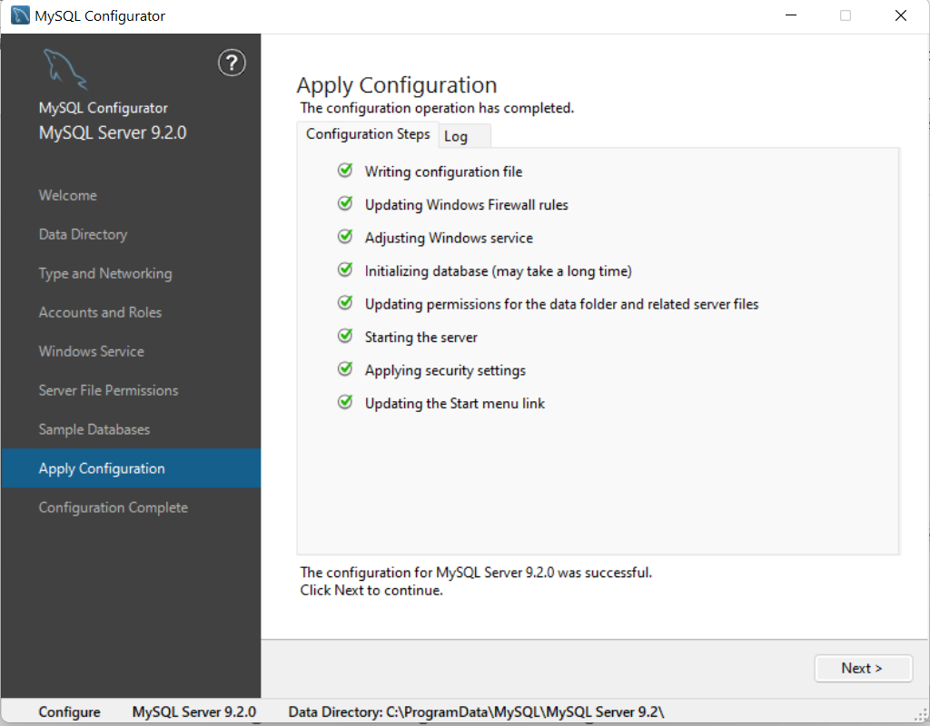
Week 2 – Lab 1
2 | Faculty of Business and Law | Peter Faber Business School

Slide 37
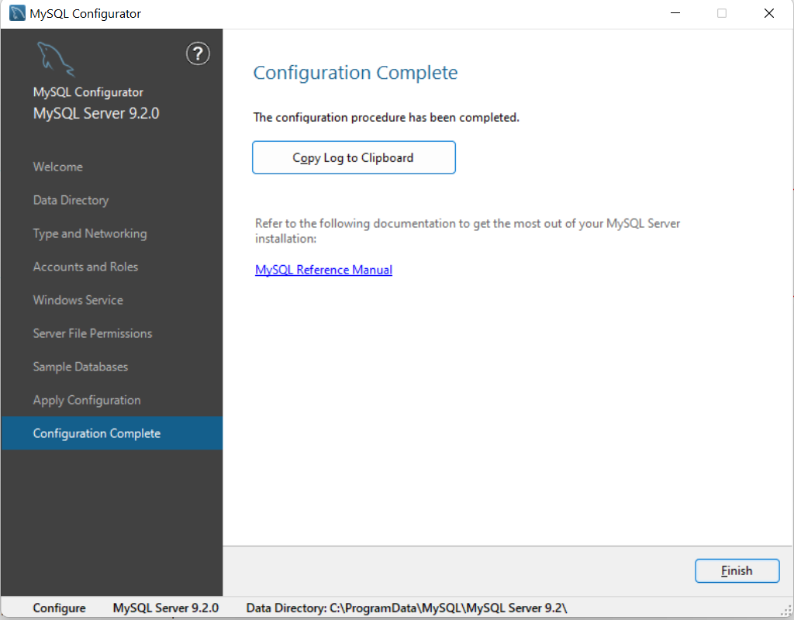
Week 2 – Lab 1
2 | Faculty of Business and Law | Peter Faber Business School

Slide 38
Week 2 – Lab 1
Downloading and Installing MySQL Workbench:
Once you have finished installing MySQL Community Server you need to set up MySQL Workbench as shown here:
Go to the MySQL Workbench Download Page Open MySQL Workbench Download in your browser. Or https://dev.mysql.com/downloads/workbench/
2 | Faculty of Business and Law | Peter Faber Business School

Slide 39
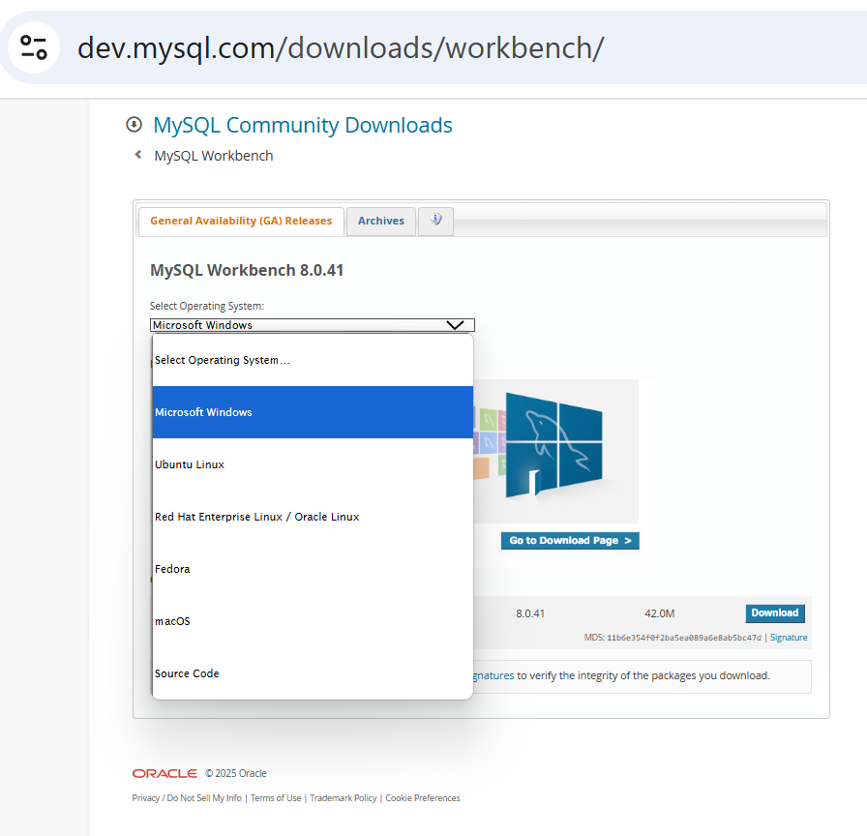
Week 2 – Lab 1
Downloading and Installing MySQL Workbench:
Choose OS and Click ‘Download’
2 | Faculty of Business and Law | Peter Faber Business School

Slide 40
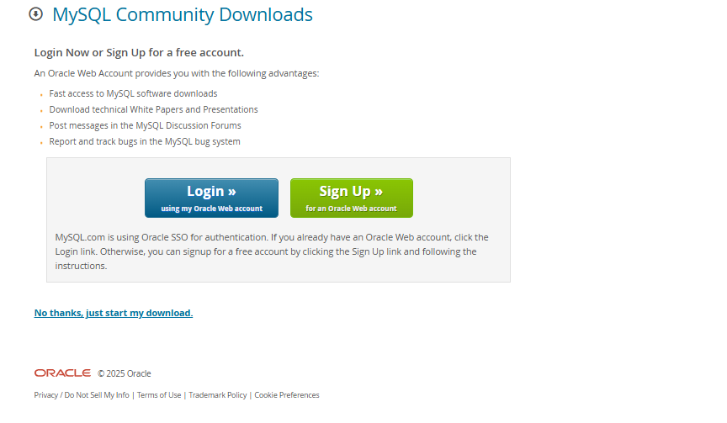
Week 2 – Lab 1
You can click ‘No thanks, just start my download’
2 | Faculty of Business and Law | Peter Faber Business School

Slide 41
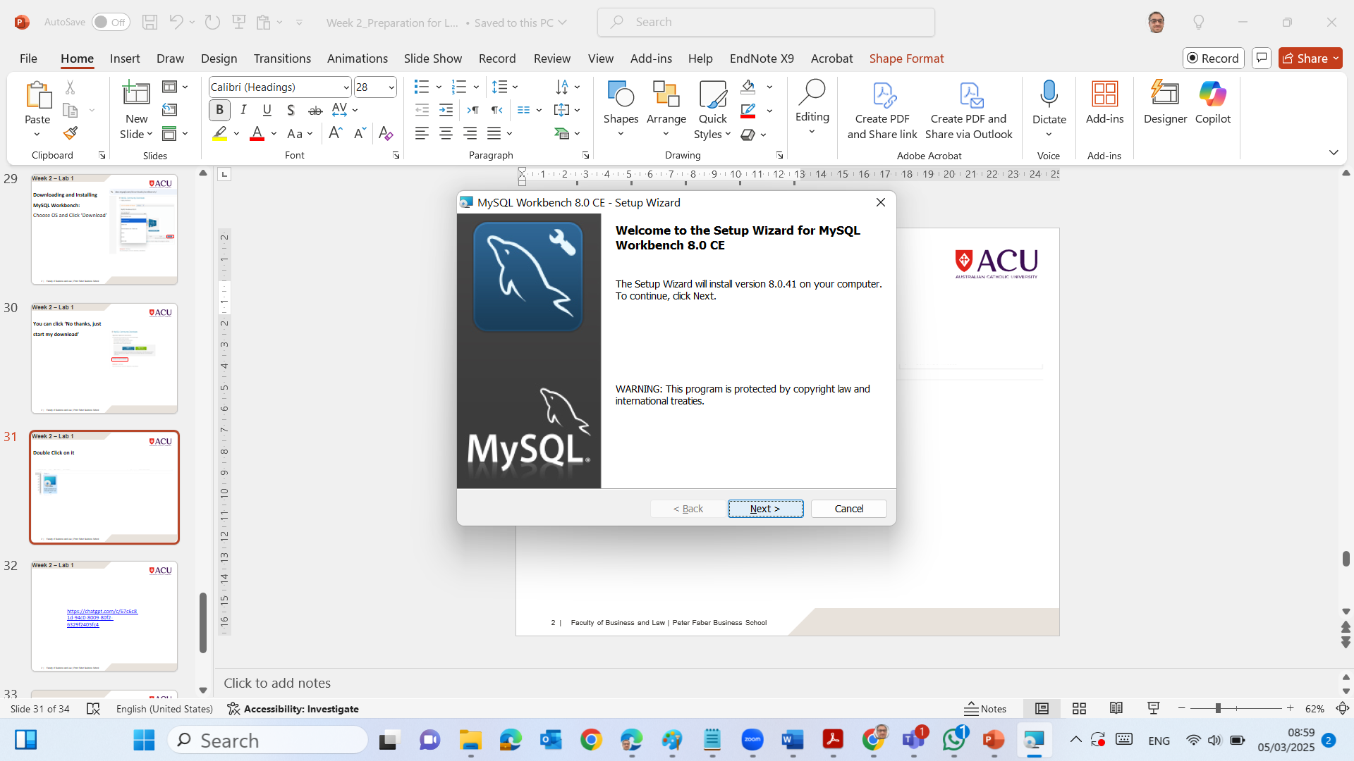
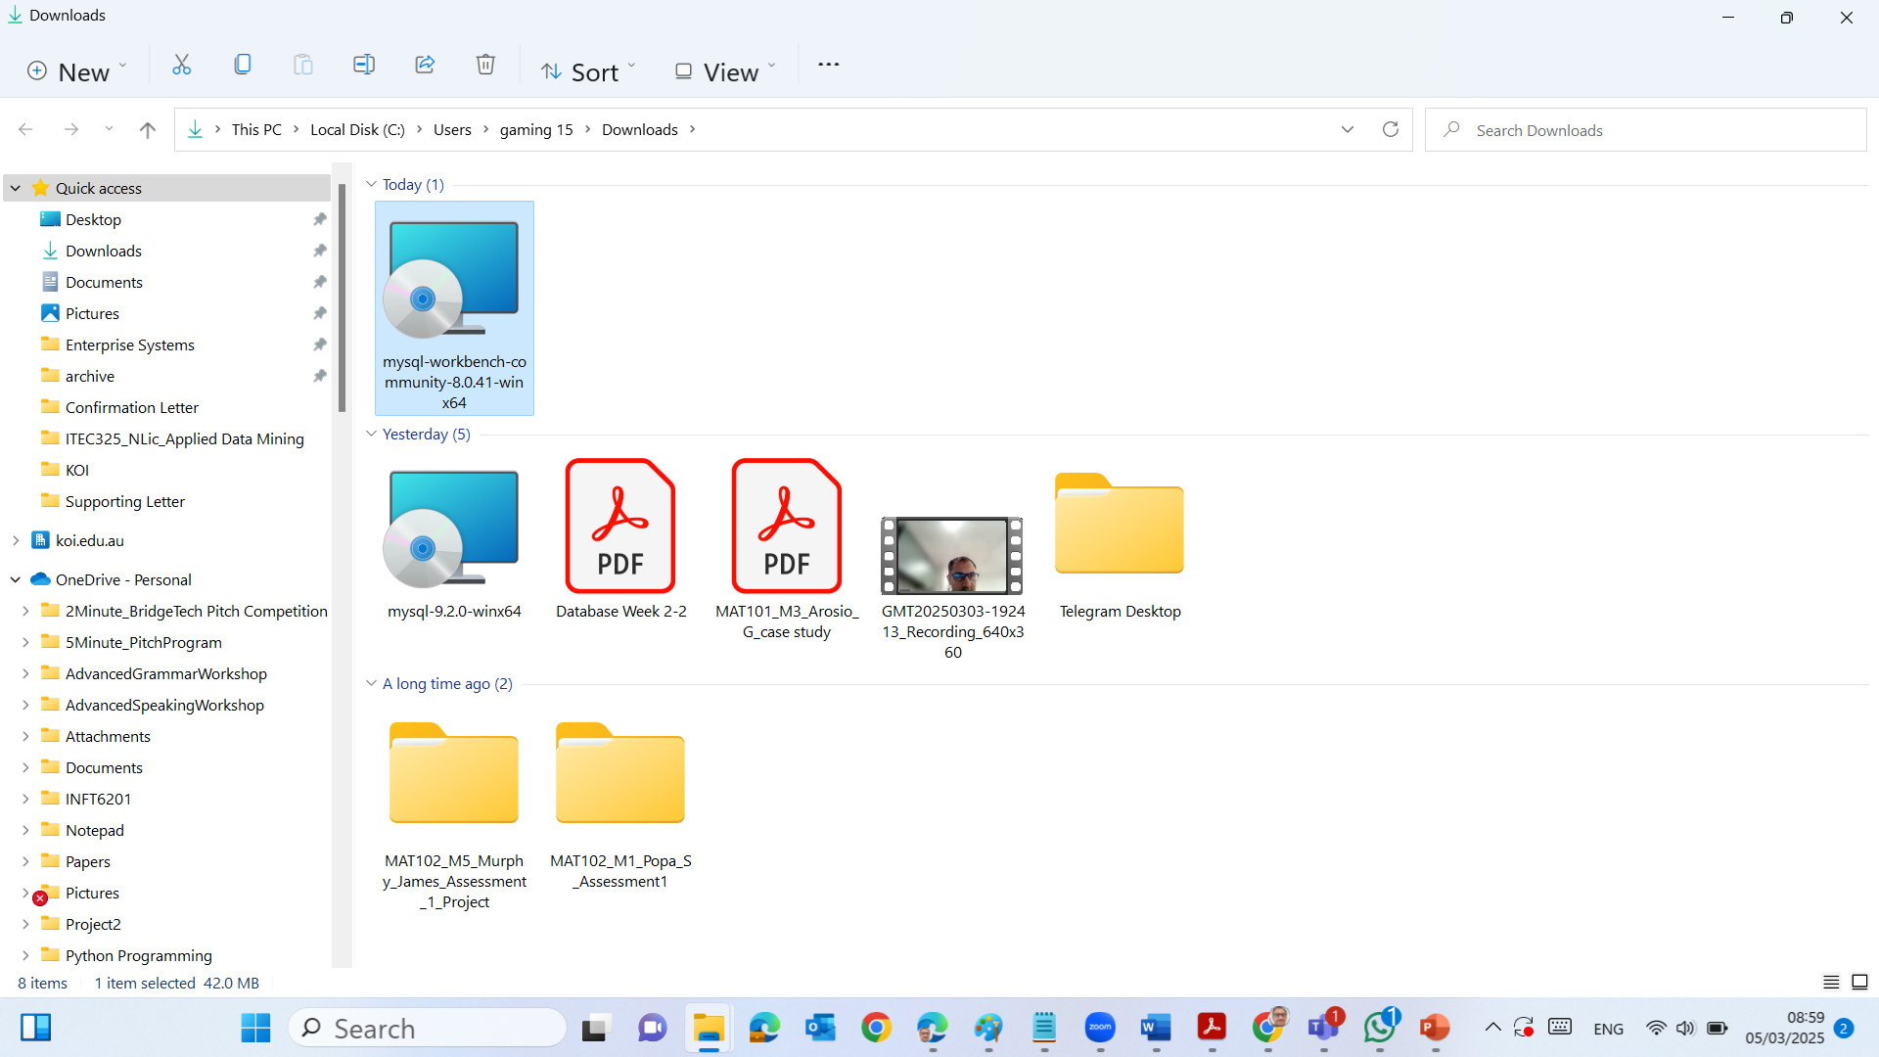
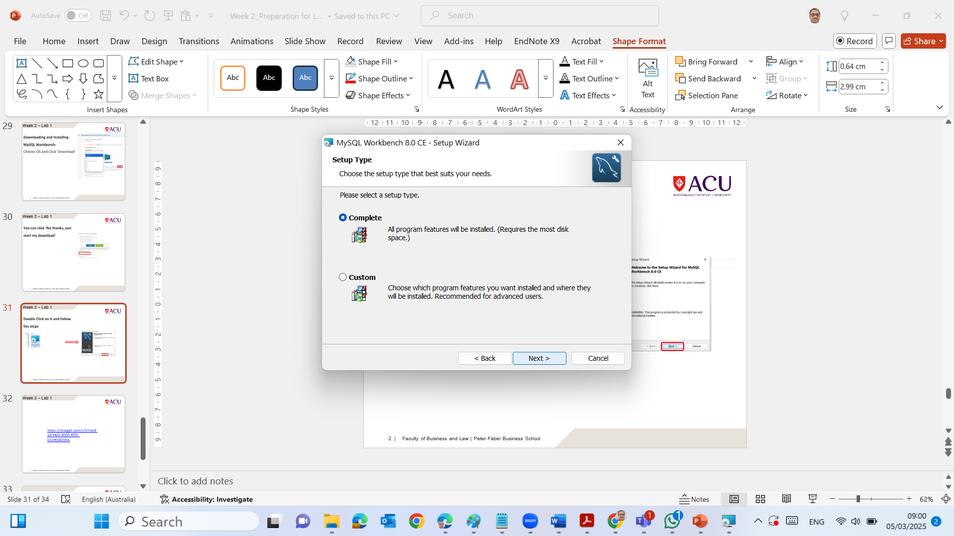
Week 2 – Lab 1
Double Click on it and follow the steps
2 | Faculty of Business and Law | Peter Faber Business School

Slide 42
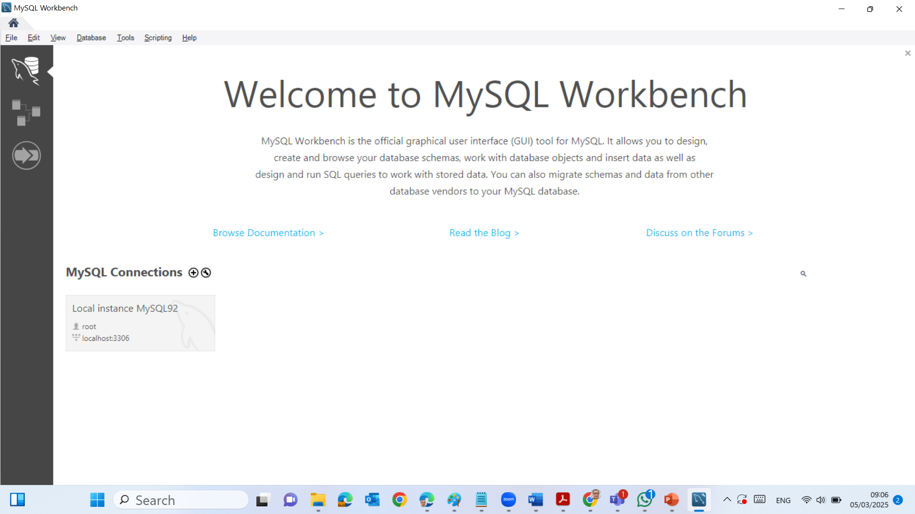
Week 2 – Lab 1
Click on Local instance MySQL92
2 | Faculty of Business and Law | Peter Faber Business School

Slide 43
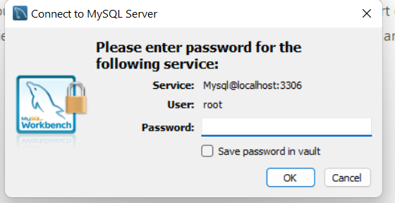
Week 2 – Lab 1
Enter your root password to connect to MySQL Server
2 | Faculty of Business and Law | Peter Faber Business School

Slide 44
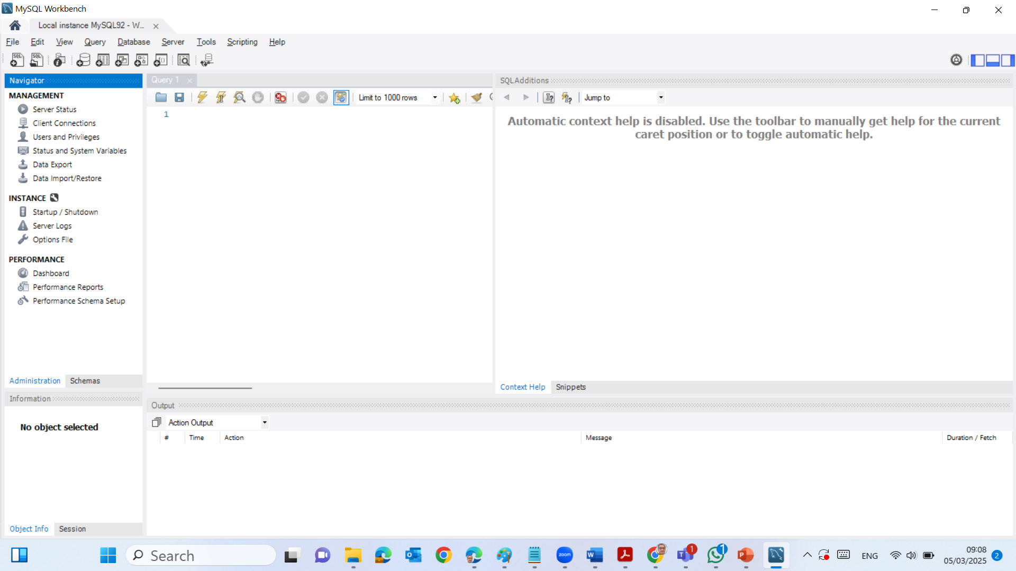
Week 2 – Lab 1
Now we have finished installing both MySQL Community Server and MySQL Workbench
2 | Faculty of Business and Law | Peter Faber Business School

Slide 45
Week 2 – Lab 1
Getting Started: ER Modeling Tools
Before starting the exercises, set up your ER modeling environment:
Choose an ER Diagram Tool
In this unit, we will use SqlDBM (recommended).
Go to: SqlDBM https://sqldbm.com/Home/
Click "Try Modelling" and create a free account to save your diagrams.
2 | Faculty of Business and Law | Peter Faber Business School

Slide 46
Week 2 – Lab 1
Getting Started: ER Modeling Tools
Alternative Online Tools (Optional)
If you prefer other tools, you can use:
Lucidchart → ERD Tool www.lucidchart.com
Draw.io → ERD Tool https://app.diagrams.net/
Visual Paradigm → ERD Tool https://online.visual-paradigm.com/
You can also use MySQL Work Bench
2 | Faculty of Business and Law | Peter Faber Business School

Slide 47
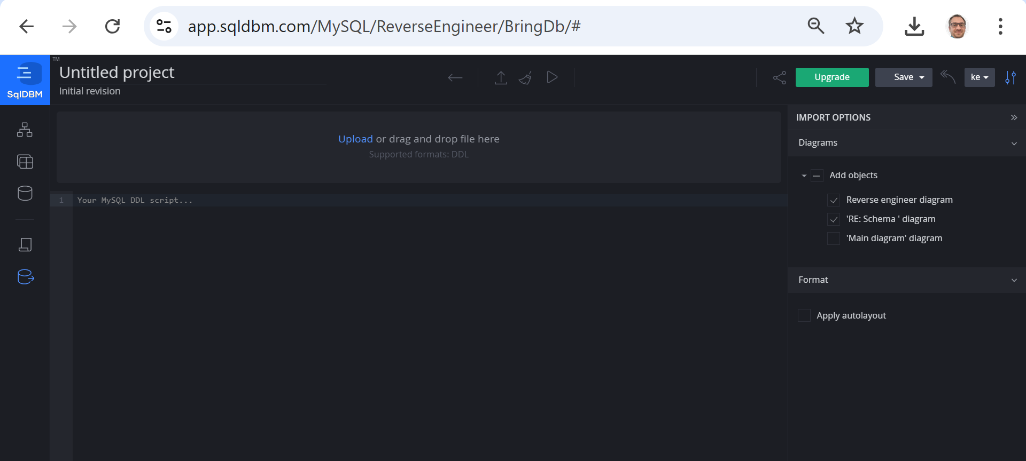
Week 2 – Lab 1
Sign-up using your email or Gmail
2 | Faculty of Business and Law | Peter Faber Business School

Slide 48
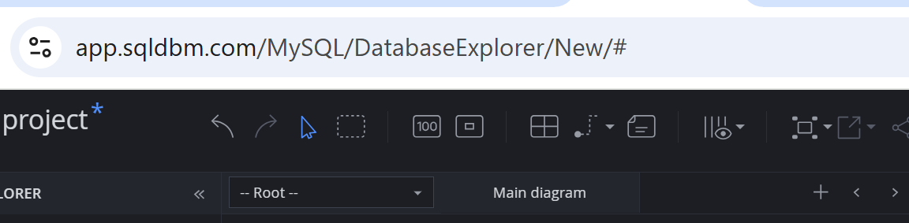
Week 2 – Lab 1
If the MySQL DDL Script is unavailable, we need to create these 9 tables
Step 1) Identify Entities (Tables) and Create each
Entities represent real-world objects in the medical clinic that will be stored in the database. Based on the requirements, the main entities are:
Patient
Doctor
Appointment
Visit
Diagnosis
Treatment
Bill
Payment
Insurance
2 | Faculty of Business and Law | Peter Faber Business School

Slide 49
Step 2) Define Primary Keys & Foreign Keys
To show FKs: we connect from Appointment Table to Patient and Doctor Table.
Table | Primary Key (PK) | Foreign Keys (FKs)
Patient | PatientID | -
Doctor | DoctorID | -
Appointment | AppointmentID | PatientID, DoctorID
Visit | VisitID | AppointmentID
Diagnosis | DiagnosisID | VisitID
Treatment | TreatmentID | VisitID
Bill | BillID | VisitID
Payment | PaymentID | -
PaymentBill (Junction Table) | (PaymentID, BillID) | PaymentID, BillID
Insurance | InsuranceID | PatientID
InsuranceClaim | ClaimID | BillID, InsuranceID
2 | Faculty of Business and Law | Peter Faber Business School

Slide 50
Step 2) Define Primary Keys & Foreign Keys
To show FKs: we connect from PaymentBill Table to Payment and Bill Table.
Table | Primary Key (PK) | Foreign Keys (FKs)
Patient | PatientID | -
Doctor | DoctorID | -
Appointment | AppointmentID | PatientID, DoctorID
Visit | VisitID | AppointmentID
Diagnosis | DiagnosisID | VisitID
Treatment | TreatmentID | VisitID
Bill | BillID | VisitID
Payment | PaymentID | -
PaymentBill (Junction Table) | (PaymentID, BillID) | PaymentID, BillID
Insurance | InsuranceID | PatientID
InsuranceClaim | ClaimID | BillID, InsuranceID
2 | Faculty of Business and Law | Peter Faber Business School

Slide 51
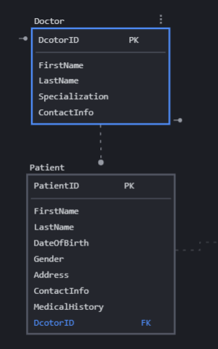
Week 2 – Lab 1
If the MySQL DDL Script is unavailable, we need to create these 9 tables
Step 3) Connections & Relationships Determination
We now define how the entities relate to each other:
One patient can have many appointments → 1:M (One-to-Many)
One Patient (1) → can book many Appointments (M).
One doctor can have many appointments → 1:M
One Doctor (1) → can have many Appointments (M).
Patient (PatientID, FirstName, LastName, DateOfBirth, Gender, Address, ContactInfo, MedicalHistory)
2 | Faculty of Business and Law | Peter Faber Business School

Slide 52
Week 2 – Lab 1
If the MySQL DDL Script is unavailable, we need to create these 9 tables
Step 3) Connections & Relationships Determination
We now define how the entities relate to each other:
One patient can have many appointments → 1:M (One-to-Many)
One Patient (1) → can book many Appointments (M).
One doctor can have many appointments → 1:M
One Doctor (1) → can have many Appointments (M).
Doctor (DoctorID, FirstName, LastName, Specialization, ContactInfo)
2 | Faculty of Business and Law | Peter Faber Business School

Slide 53
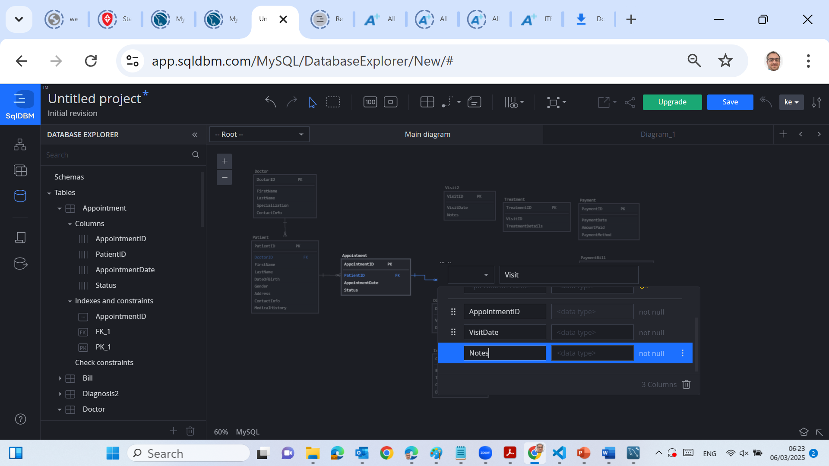
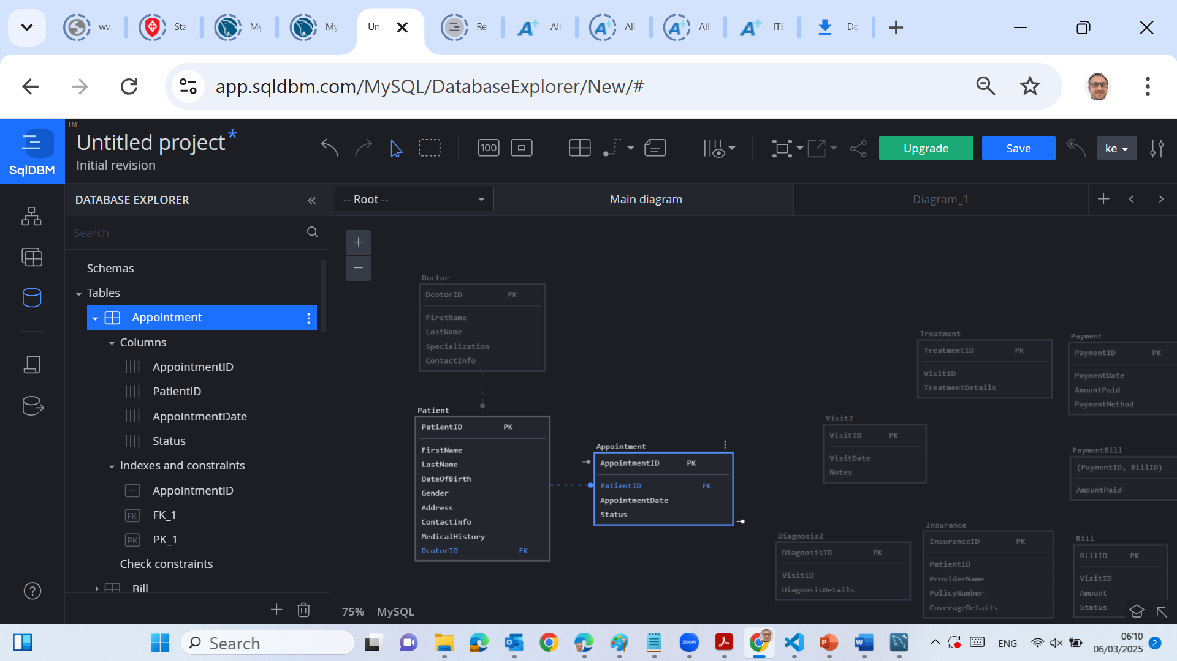
Week 2 – Lab 1
If the MySQL DDL Script is unavailable, we need to create these 9 tables
Press Tab to Enter the Next Column Name
Step 3) Connections & Relationships Determination
Each Appointment is only between one doctor and one patient → M:1
Each Appointment is uniquely linked to one Patient and one Doctor.
Each appointment results in one Visit → 1:1
One Appointment (1) → results in exactly one Visit (1).
Appointment (AppointmentID, PatientID, DoctorID, AppointmentDate, Status)
Visit (VisitID, AppointmentID, VisitDate, Notes)
2 | Faculty of Business and Law | Peter Faber Business School

Slide 54
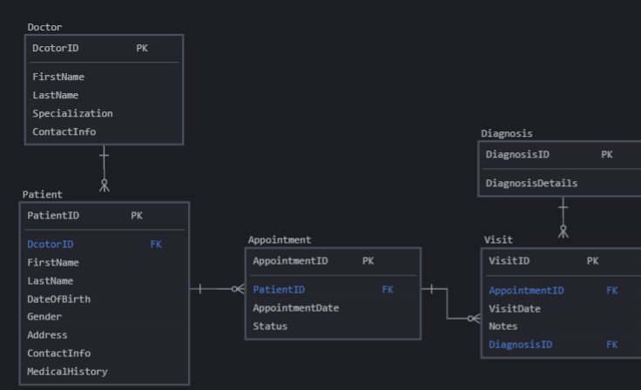
Week 2 – Lab 1
If the MySQL DDL Script is unavailable, we need to create these 9 tables
Step 3) Connections & Relationships Determination
One visit can have multiple diagnoses → 1:M
One Visit (1) → can have many Diagnoses (M).
Diagnosis (DiagnosisID, VisitID, DiagnosisDetails)
2 | Faculty of Business and Law | Peter Faber Business School

Slide 55
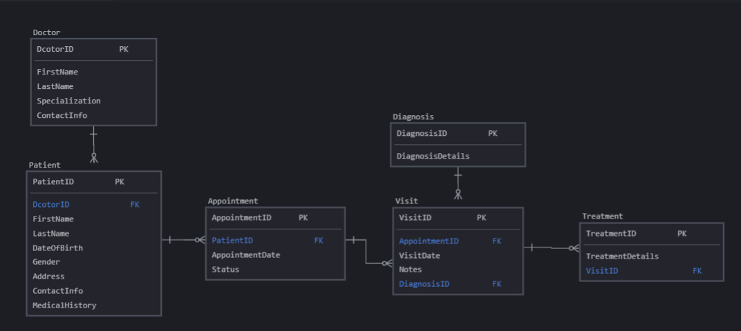
Week 2 – Lab 1
If the MySQL DDL Script is unavailable, we need to create these 9 tables
Step 3) Connections & Relationships Determination
One visit can have multiple treatments → 1:M
One Visit (1) → can have many Treatments (M).
Treatment (TreatmentID, VisitID, TreatmentDetails)
2 | Faculty of Business and Law | Peter Faber Business School

Slide 56
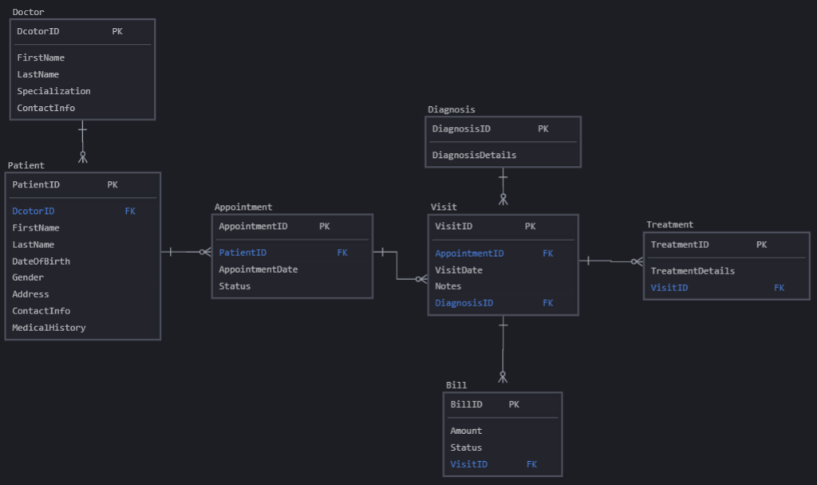
Week 2 – Lab 1
If the MySQL DDL Script is unavailable, we need to create these 9 tables
Step 3) Connections & Relationships Determination
Each visit generates exactly one bill → 1:1
One Visit (1) → results in exactly one Bill (1).
A bill can be paid fully or in installments → M:N
One Bill (1) → can have many Payments (M).
One Payment (1) → can cover multiple Bills (M).
Bill (BillID, VisitID, Amount, Status)
2 | Faculty of Business and Law | Peter Faber Business School

Slide 57
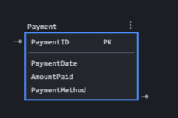
Week 2 – Lab 1
If the MySQL DDL Script is unavailable, we need to create these 9 tables
Step 3) Connections & Relationships Determination
Each visit generates exactly one bill → 1:1
One Visit (1) → results in exactly one Bill (1).
A bill can be paid fully or in installments → M:N
One Bill (1) → can have many Payments (M).
One Payment (1) → can cover multiple Bills (M).
Payment (PaymentID, PaymentDate, AmountPaid, PaymentMethod)
2 | Faculty of Business and Law | Peter Faber Business School

Slide 58
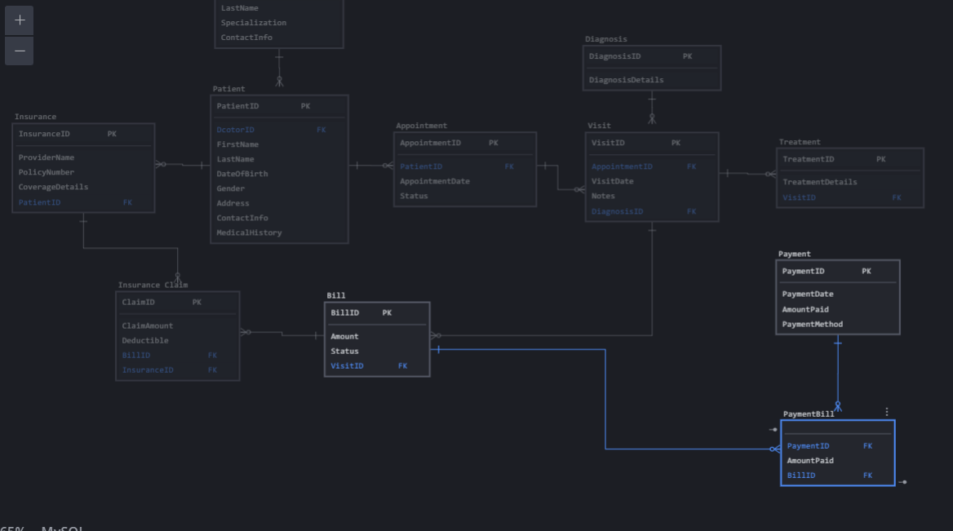
Week 2 – Lab 1
If the MySQL DDL Script is unavailable, we need to create these 9 tables
Step 3) Connections & Relationships Determination
Each visit generates exactly one bill → 1:1
One Visit (1) → results in exactly one Bill (1).
A bill can be paid fully or in installments → M:N
One Bill (1) → can have many Payments (M).
One Payment (1) → can cover multiple Bills (M).
PaymentBill (PaymentID, BillID, AmountPaid)
2 | Faculty of Business and Law | Peter Faber Business School

Slide 59
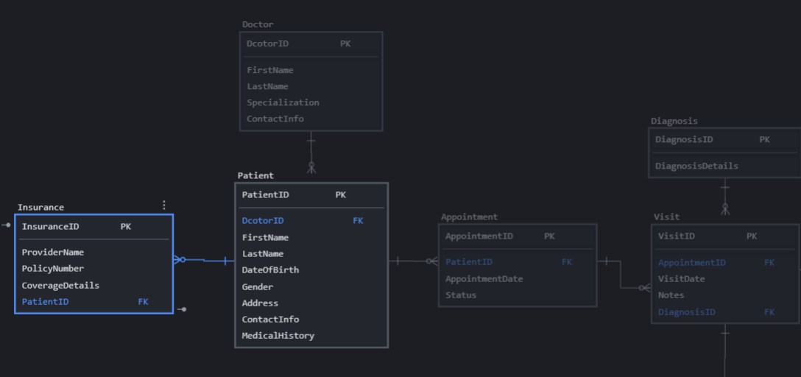
Week 2 – Lab 1
If the MySQL DDL Script is unavailable, we need to create these 9 tables
Step 3) Connections & Relationships Determination
A patient can have one insurance policy → 1:1
One Patient (1) → can have at most one Insurance policy (1).
A bill can be covered by one insurance claim → 1:1
One Bill (1) → can have one InsuranceClaim (1).
Insurance (InsuranceID, PatientID, ProviderName, PolicyNumber, CoverageDetails)
2 | Faculty of Business and Law | Peter Faber Business School

Slide 60
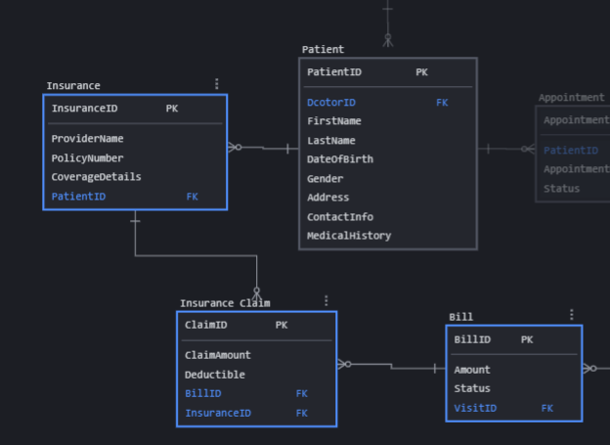
Week 2 – Lab 1
If the MySQL DDL Script is unavailable, we need to create these 9 tables
Step 3) Connections & Relationships Determination
A patient can have one insurance policy → 1:1
One Patient (1) → can have at most one Insurance policy (1).
A bill can be covered by one insurance claim → 1:1
One Bill (1) → can have one InsuranceClaim (1).
InsuranceClaim (ClaimID, BillID, InsuranceID, ClaimAmount, Deductible)
2 | Faculty of Business and Law | Peter Faber Business School

Slide 61
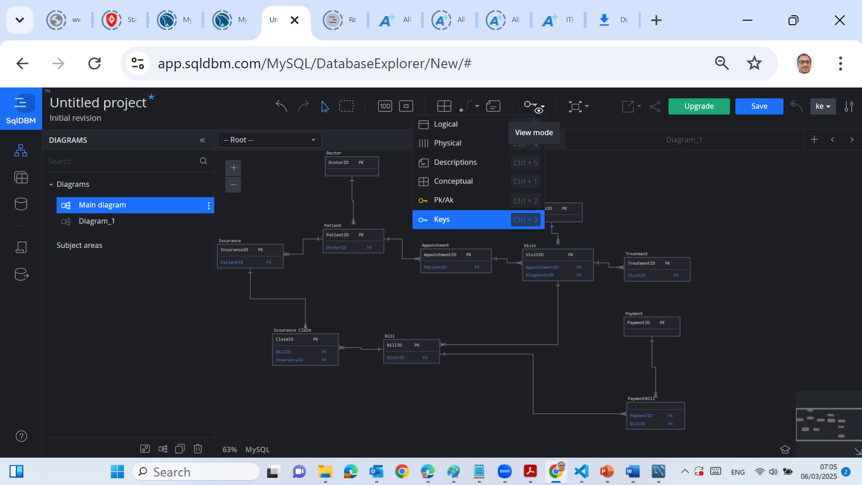
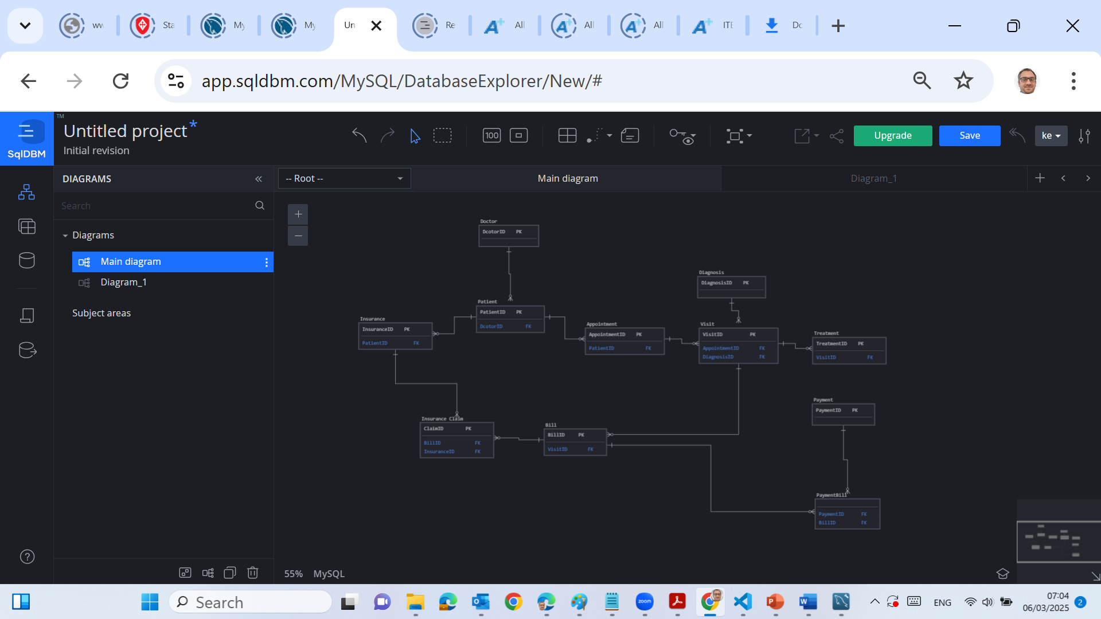
Week 2 – Lab 1
If the MySQL DDL Script is unavailable, we need to create these 9 tables
To see Keys View
2 | Faculty of Business and Law | Peter Faber Business School

Slide 62
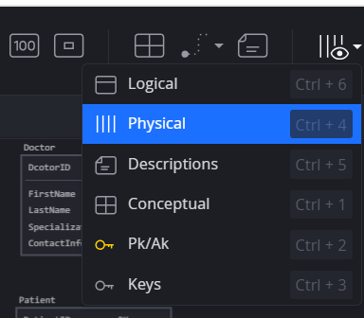
Step 4) Use Crow’s Foot Notation for Relationships
To visualize relationships (Physical View)
One-to-Many (1:M) → Crow’s Foot Notation
A single patient can have many appointments.
A single doctor can have many appointments.
A single visit can have multiple diagnoses/treatments.
Many-to-Many (M:N)
Payments & Bills → Convert to junction table (PaymentBill).
2 | Faculty of Business and Law | Peter Faber Business School

Slide 63
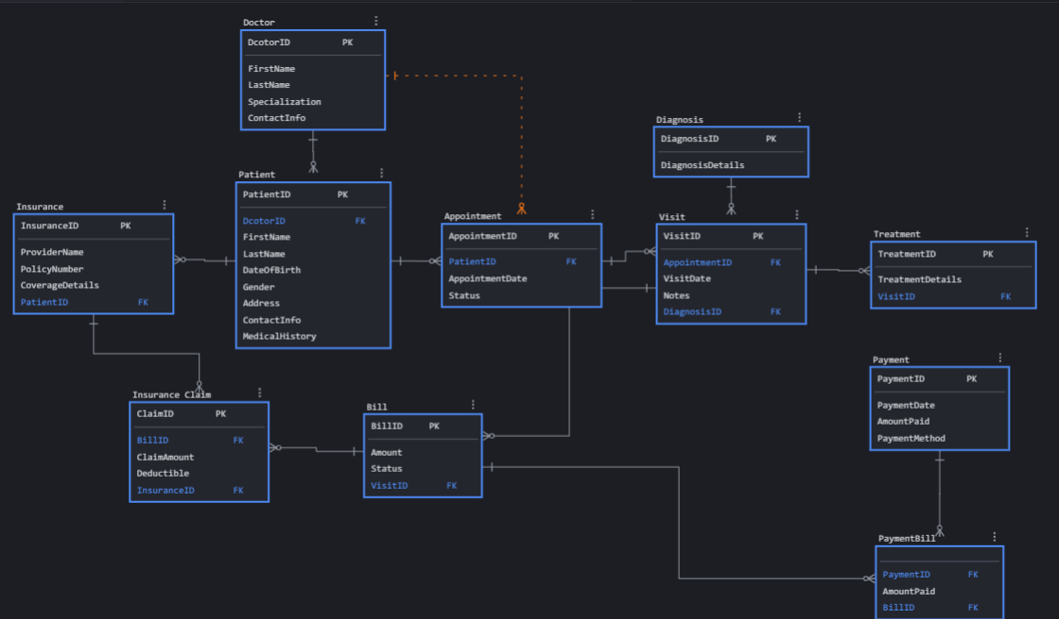
Step 4) Use Crow’s Foot Notation for Relationships
2 | Faculty of Business and Law | Peter Faber Business School

Slide 64
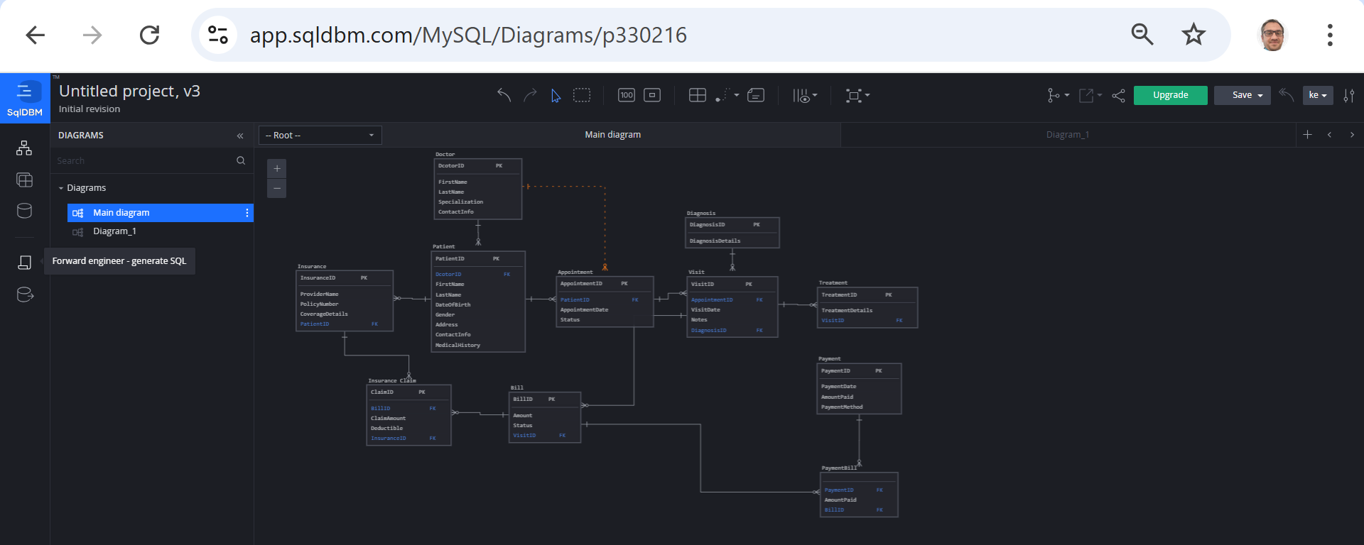
Step 5) Generate SQL Code from SqlDBM
Our ERD is now complete in SqlDBM. Click on Forward Engineer – generate SQL
2 | Faculty of Business and Law | Peter Faber Business School

Slide 65
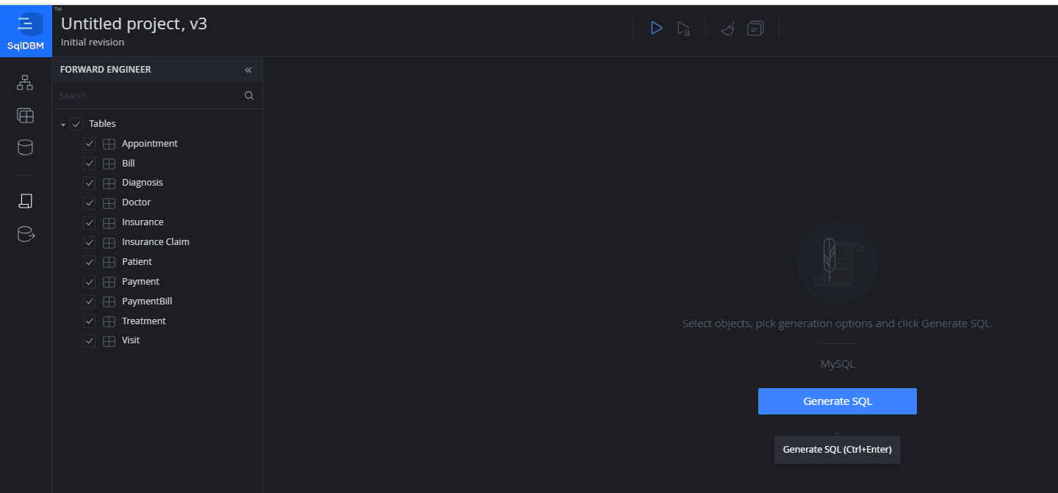
Step 5) Generate SQL Code from SqlDBM (Optional as it may require a full-upgrade version)
Our ERD is now complete in SqlDBM. Click on Forward Engineer – generate SQL
Check for missing Foreign Keys → Ensure all constraints are included.
Copy and save the generated SQL script.
2 | Faculty of Business and Law | Peter Faber Business School

Slide 66
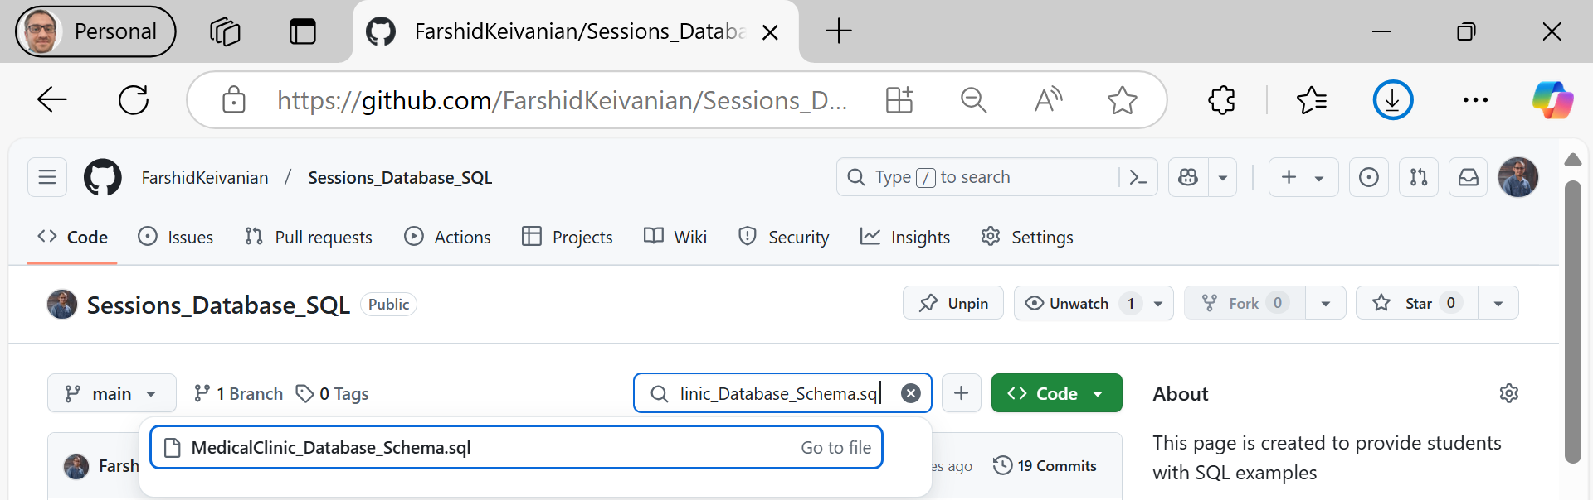
Step 6) SQL Code for the Database Schema
We can Copy & Paste this SQL into MySQL Workbench.
Run the script to create tables and insert sample data.
2 | Faculty of Business and Law | Peter Faber Business School

Slide 67
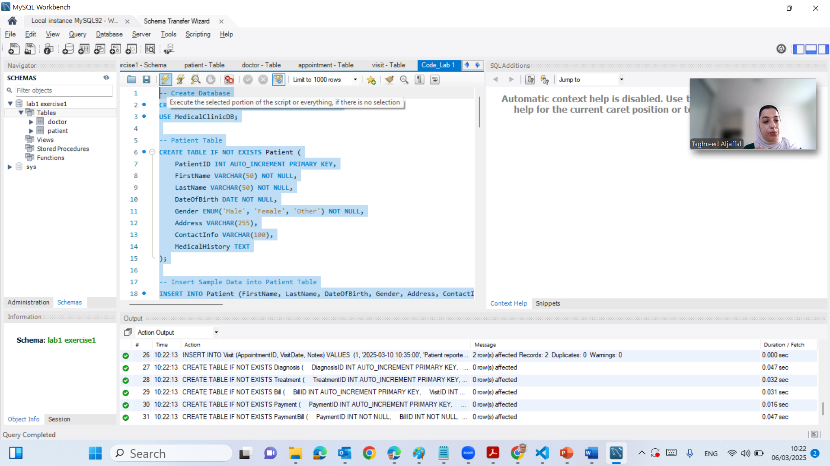
Step 6) SQL Code for the Database Schema
2 | Faculty of Business and Law | Peter Faber Business School

Slide 68
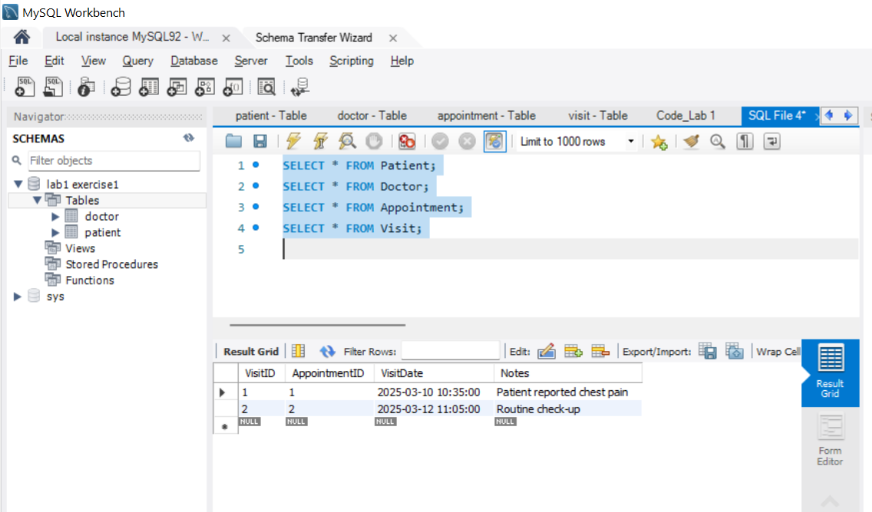
Step 6) SQL Code for the Database Schema
Verify the data using
SELECT * FROM Patient;
SELECT * FROM Doctor;
SELECT * FROM Appointment;
SELECT * FROM Visit;
2 | Faculty of Business and Law | Peter Faber Business School

Slide 69
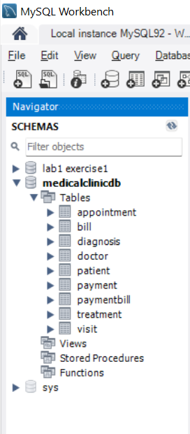
Step 6) SQL Code for the Database Schema
View Created Tables in MySQL Workbench
Open MySQL Workbench.
On the left panel (Navigator), under the Schemas section:
Click the refresh icon next to "Schemas".
Locate your database (e.g., MedicalClinicDB).
Expand it by clicking the "+" sign.
Click on "Tables" to see the list of tables.
2 | Faculty of Business and Law | Peter Faber Business School

Slide 70
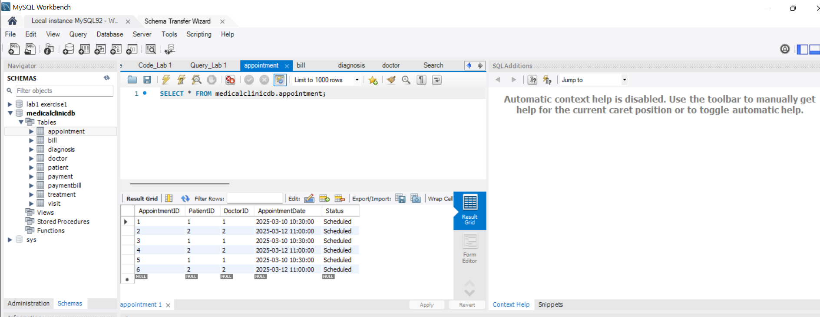
Step 6) SQL Code for the Database Schema
Double Click to See each Table
2 | Faculty of Business and Law | Peter Faber Business School

Slide 71
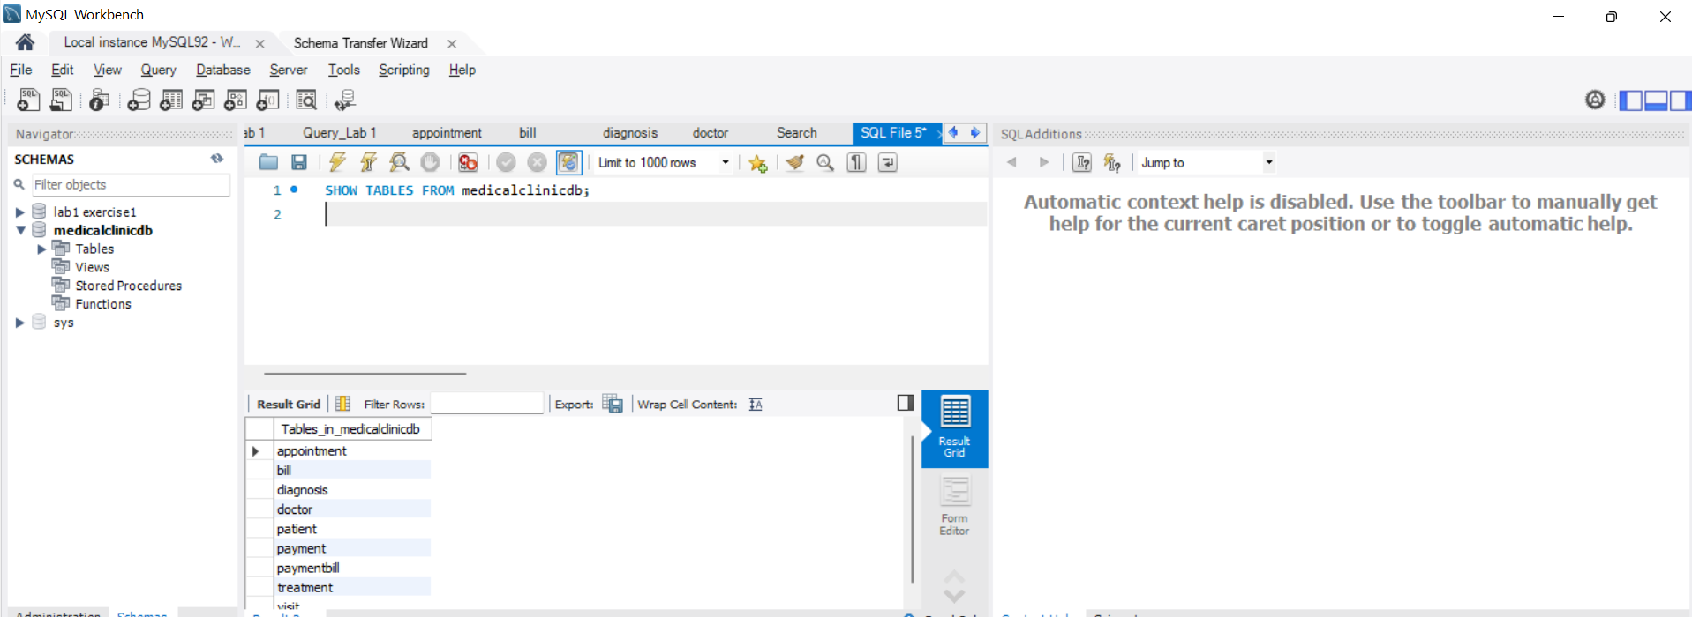
Step 6) SQL Code for the Database Schema
SQL command to show all tables
SHOW TABLES FROM medicalclinicdb;
2 | Faculty of Business and Law | Peter Faber Business School

Slide 72
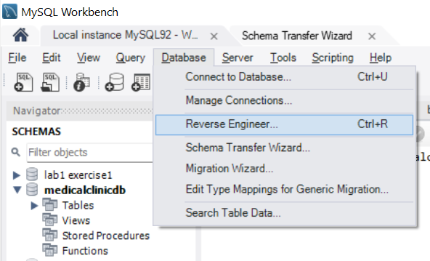
Step 6) SQL Code for the Database Schema
See all tables graphically
Go to Database → Reverse Engineer.
Select your database (medicalclinicdb).
MySQL Workbench will generate an ER diagram showing all tables and relationships.
2 | Faculty of Business and Law | Peter Faber Business School

Slide 73
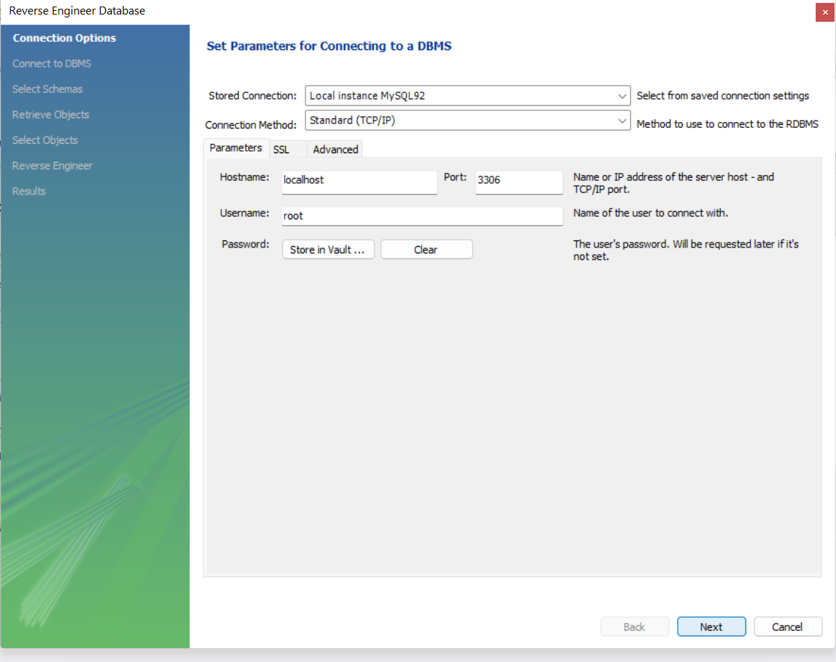
Step 6) SQL Code for the Database Schema
See all tables graphically
2 | Faculty of Business and Law | Peter Faber Business School

Slide 74
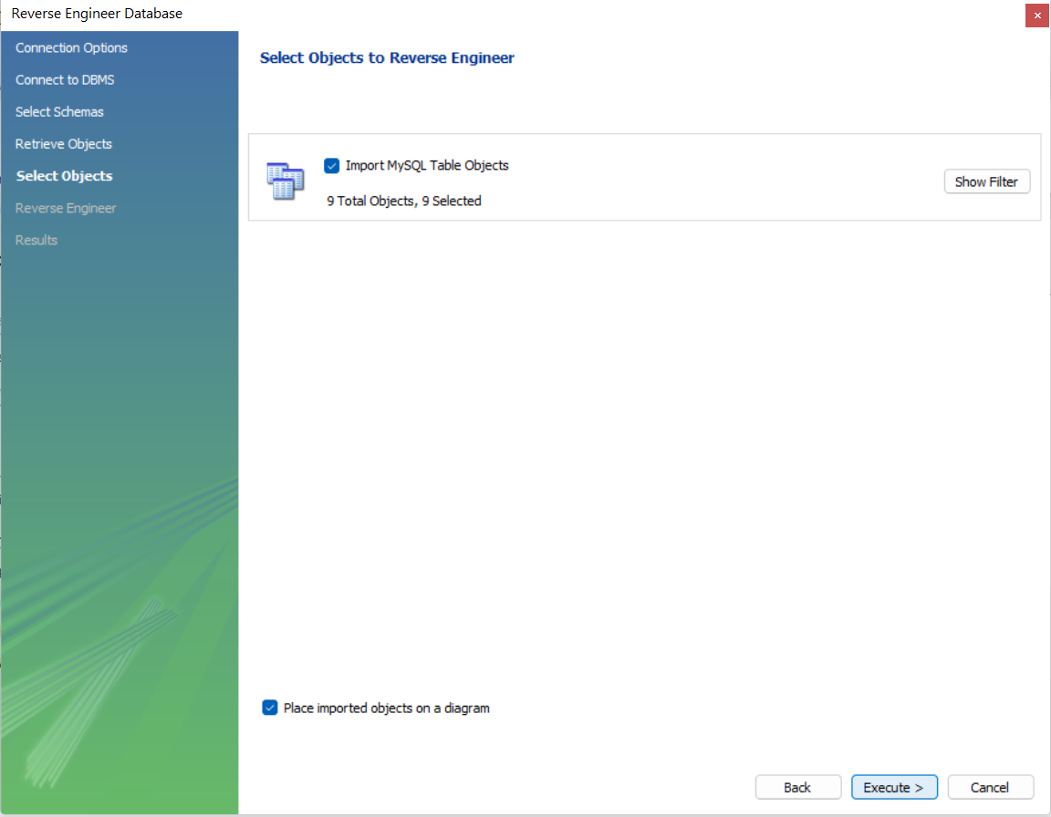
Step 6) SQL Code for the Database Schema
See all tables graphically
2 | Faculty of Business and Law | Peter Faber Business School

Slide 75

Step 6) SQL Code for the Database Schema
See all tables graphically on MySQL Workbench
2 | Faculty of Business and Law | Peter Faber Business School

Slide 76

What is this ERD about?
This ERD (Entity-Relationship Diagram) shows how a Medical Clinic Database is structured. It helps us understand how different tables (entities) are related to each other.
2 | Faculty of Business and Law | Peter Faber Business School

Slide 77
Patient Table
Stores basic information about patients.
Includes PatientID (Primary Key), Name, Date of Birth, Gender, Address, Contact Info, and Medical History.
Each patient can have multiple appointments.
2 | Faculty of Business and Law | Peter Faber Business School

Slide 78
Doctor Table
Contains details of doctors in the clinic.
Includes DoctorID (Primary Key), Name, Specialization, and Contact Info.
One doctor can handle multiple appointments.
2 | Faculty of Business and Law | Peter Faber Business School

Slide 79
Appointment Table
Tracks appointments between patients and doctors.
Includes AppointmentID (Primary Key), PatientID (Foreign Key), DoctorID (Foreign Key), Appointment Date, and Status.
Each appointment belongs to ONE patient and ONE doctor.
2 | Faculty of Business and Law | Peter Faber Business School

Slide 80
Visit Table
After an appointment, a visit record is created.
Includes VisitID (Primary Key), AppointmentID (Foreign Key), Visit Date, and Notes.
Each appointment results in ONE visit.
2 | Faculty of Business and Law | Peter Faber Business School

Slide 81
Diagnosis Table
Stores diagnoses given during visits.
Includes DiagnosisID (Primary Key), VisitID (Foreign Key), and Diagnosis Details.
One visit can have multiple diagnoses.
2 | Faculty of Business and Law | Peter Faber Business School

Slide 82
Treatment Table
Stores treatments prescribed during a visit.
Includes TreatmentID (Primary Key), VisitID (Foreign Key), and Treatment Details.
One visit can have multiple treatments.
2 | Faculty of Business and Law | Peter Faber Business School

Slide 83
Bill Table
Stores billing details for each visit.
Includes BillID (Primary Key), VisitID (Foreign Key), Amount, and Status (Pending, Paid, etc.).
Each visit generates ONE bill
2 | Faculty of Business and Law | Peter Faber Business School

Slide 84
Payment Table
Stores details of payments made by patients.
Includes PaymentID (Primary Key), Payment Date, Amount Paid, and Payment Method (Cash, Credit Card, Insurance, etc.).
One payment can cover multiple bills.
2 | Faculty of Business and Law | Peter Faber Business School

Slide 85
PaymentBill Table
A junction table (for many-to-many relationships).
Connects payments to bills.
Includes PaymentID and BillID (Foreign Keys).
One bill can be paid in multiple payments, and one payment can cover multiple bills.
2 | Faculty of Business and Law | Peter Faber Business School

Slide 86
Understanding Relationships
One-to-Many (1:M) Relationships
These relationships are shown using lines with "crow’s feet" (three small lines at one end). For example:
One patient → can have many appointments.
One doctor → can have many appointments.
One appointment → results in one visit.
One visit → can have multiple diagnoses and multiple treatments.
2 | Faculty of Business and Law | Peter Faber Business School

Slide 87
Many-to-Many (M:M) Relationships
A bill can be paid in multiple payments, and one payment can cover multiple bills.
The PaymentBill table is used to handle this many-to-many relationship.
2 | Faculty of Business and Law | Peter Faber Business School

Slide 88
3. Why is This ERD Important?
It helps organize medical records properly.
Ensures data consistency (e.g., a bill is always linked to a visit).
Helps prevent duplicate records.
Makes report generation easier (e.g., "Show all unpaid bills for a patient").
2 | Faculty of Business and Law | Peter Faber Business School

Slide 89
Conclusion
This Medical Clinic Database follows real-world hospital management systems. It stores patient records, doctor appointments, diagnoses, treatments, bills, and payments in a structured way.
Key Takeaway: AI and automation can help medical clinics manage their operations efficiently!
Question for Discussion:
How can AI be integrated into this system to improve patient care and automate tasks?
2 | Faculty of Business and Law | Peter Faber Business School

Slide 90

Week 2 – Lab 1
If the MySQL DDL Script is available:
Click 'Main diagram' under Diagrams in the Import Options.
Enter the MySQL DDL script in the editor.
If you have an existing database script, you can upload it or paste the SQL script manually.
If not, you can manually create the tables and relationships by adding entities.
Click the 'Run' (▶️) button or use the 'Save' option to generate the diagram.
Enable 'Apply Autolayout' if you want SQLDBM to arrange the entities automatically.
Once the diagram is generated, adjust the table placements to clearly visualize the relationships.
2 | Faculty of Business and Law | Peter Faber Business School

Slide 91

Week 2 – Lab 1
If the MySQL DDL Script is available:
2 | Faculty of Business and Law | Peter Faber Business School

Slide 92

Week 2 – Lab 1
If the MySQL DDL Script is available:
2 | Faculty of Business and Law | Peter Faber Business School

Slide 93
Thank You
Have a Great Learning Day!
Feel free to reach out with any questions!
Dr. Farshid Keivanian

